Slide 1
Software and Software Engineering

Slide 2
Content
Software Definition
Characteristics
Applications
Layered Technology
Software Process
Process Framework Activities
Umbrella Activities
General Principles

Slide 3
Def of Software
Software is:
instructions (computer programs) that when executed provide desired features, function, and performance;
data structures that enable the programs to adequately manipulate information, and
descriptive information in both hard copy and virtual forms that describes the operation and use of the programs.

Slide 4
Software’s Dual Role
Software is a product
Delivers computing potential
Produces, manages, acquires, modifies, displays, or transmits information
Software is a vehicle for delivering a product
Supports or directly provides system functionality
Controls other programs (e.g., an operating system)
Effects communications (e.g., networking software)
Helps build other software (e.g., software tools)

Slide 5
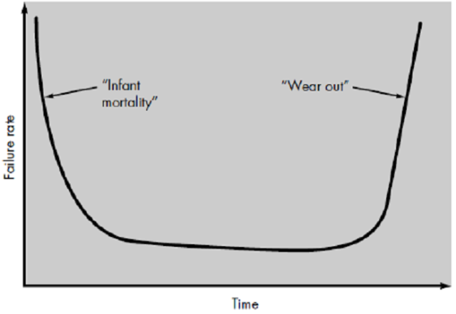
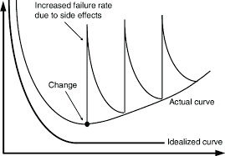
Characteristics
Failure curve for hardware
Software is developed or engineered not manufactured
Software doesn’t “wear out.”
Industry is moving toward component-based construction, most software continues to be custom built
Failure curves for software

Slide 6
Software Applications
System software
Application software
Engineering/scientific software
Embedded software
Product-line software
WebApps (Web applications)
AI software
New Categories
Open world computing—pervasive, distributed computing
Ubiquitous computing—wireless networks
Netsourcing—the Web as a computing engine
Open source—”free” source code open to the computing community
Legacy Software

Slide 7
WebApps - Nature
Network intensiveness
Concurrency
Unpredictable load
Performance
Availability
Data driven
Content sensitive
Continuous evolution
Immediacy
Security
Aesthetics

Slide 8
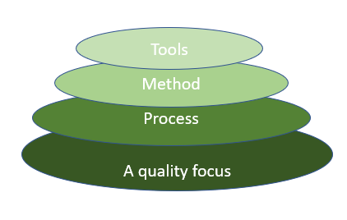
Layered Technology in Software Engineering
A quality focus:
It provides integrity so that data can be accessed by only an authorized person, no outsider can access the data.
It also focuses on maintainability and usability.
2. Process:
key which enables the development of software before the deadline or on time.
defines a framework that must be established for the effective delivery of software engineering technology.
covers all the activities, actions, and tasks required to be carried out for software development.
3. Method:
the answers to all “how-to-do” questions are given by method.
It has the information of all the tasks which includes communication, requirement analysis, design modeling, program construction, testing, and support.
4. Tools:
provide a self-operating system for processes and methods.
integrated which means information created by one tool can be used by another.

Slide 9
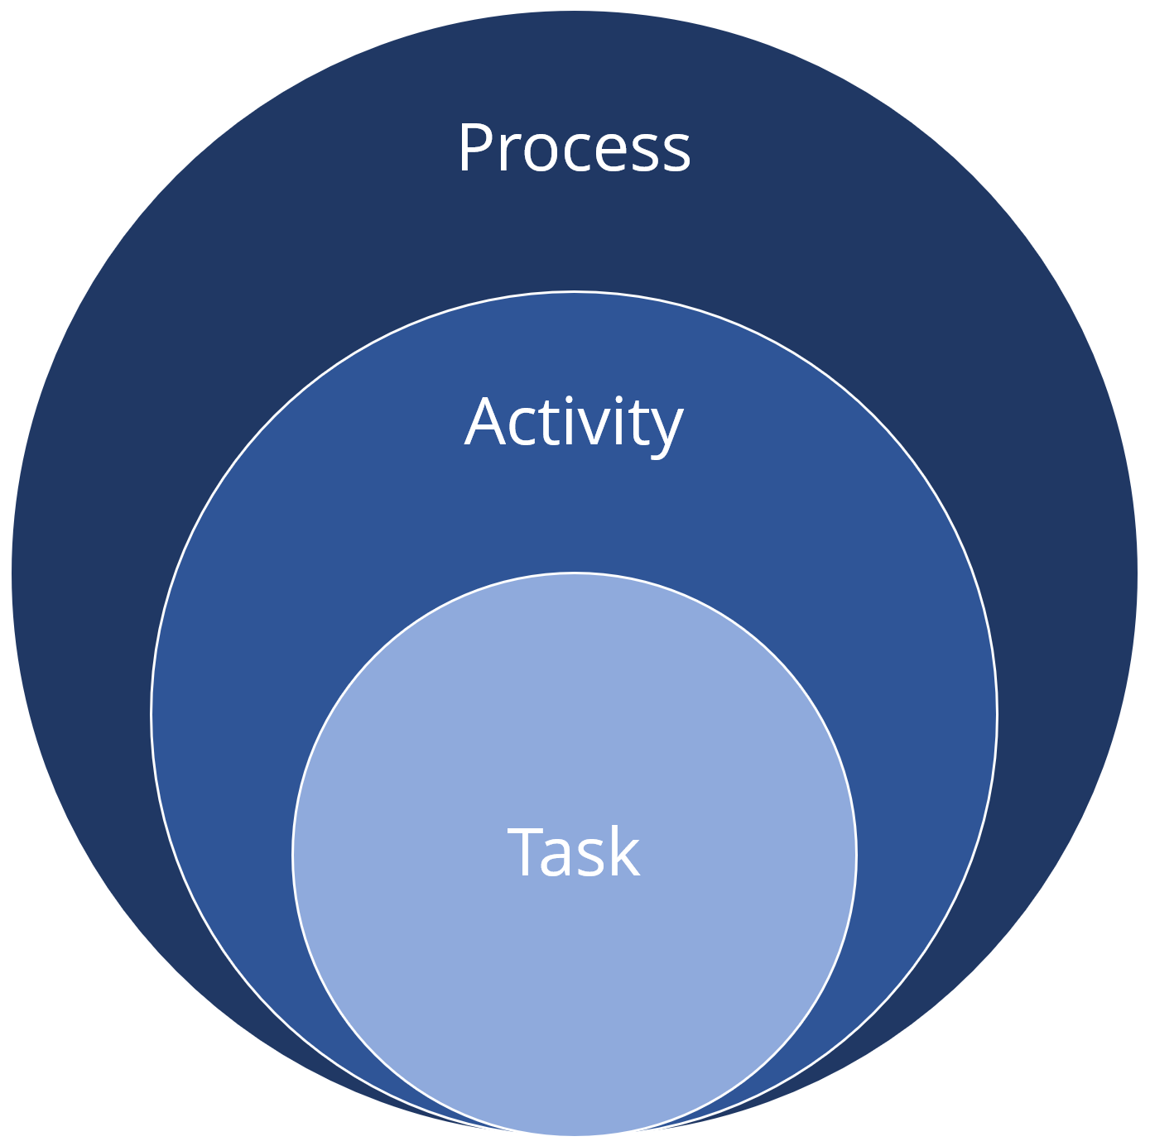
The Software Process
Elements
Process
Activity
Task
Collection of Activities, Actions and Tasks that are performed when some work product is created
An activity strives to achieve a broad objective
applied regardless of the application domain, size of the project, complexity of the effort
focuses on a small, but well-defined objective that produces a tangible outcome
Action
a set of tasks that produce a major work product

Slide 10
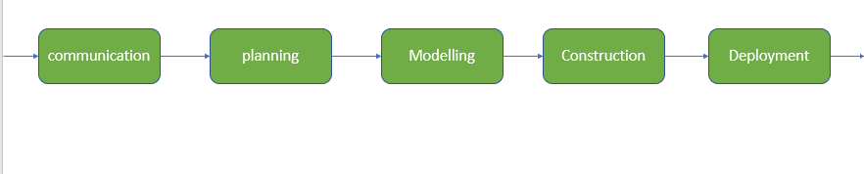
Process Framework Activities
Communication: It is the first and foremost thing to know the actual demand of the client.
Planning: It basically means drawing a map for reduced the complication of development.
Modeling: In this process, a model is created according to the client for better understanding.
Construction: It includes the coding and testing of the problem.
Deployment:- It includes the delivery of software to the client for evaluation and feedback.

Slide 11
Process Framework Activities
Supplemented by Umbrella Activities - occur throughout the software process and focus primarily on project management, tracking, and control.
Software project tracking and control
Risk management
Software quality assurance
Technical reviews
Measurement—defines and collects process, project, and product measures that assist the team in delivering software that meets stakeholders’ needs;
Software configuration management
Reusability management
Work product preparation and production—encompasses the activities required to create work products such as models, documents, logs, forms, and lists.

Slide 12
General Principles of SE
The Reason It All Exists
KISS (Keep It Simple, Stupid!)
Maintain the Vision
What You Produce, Others Will Consume
Be Open to the Future
Plan Ahead for Reuse
Think!

